Slide 1
A Christmas Carol
Charles Dickens

Slide 2
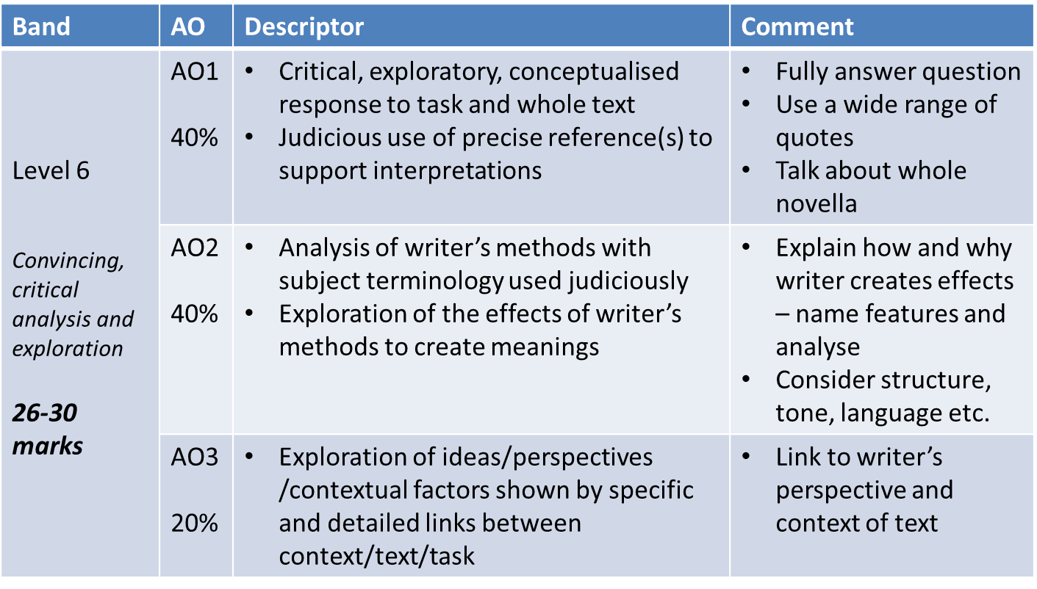
Assessment criteria

Slide 3
Key quote #1
“Oh! but he was a tight-fisted hand at the grindstone, Scrooge! a squeezing, wrenching, grasping, scraping, clutching, covetous old sinner!”
On Scrooge - Stave 1

Slide 4
Key quote #2
“If they would rather die.. They had better do it, and decrease the surplus population.”
Scrooge - Stave 1

Slide 5
Key quote #3
“Mankind was my business. The common welfare was my business; charity, mercy, forbearance, and benevolence were, all, my business.”
Marley (Dickens’ perspective) - Stave 1

Slide 6
Key quote #4
“Another idol has displaced me… Our contract is an old one. It was made when we were both poor, and content to be so… You are changed.”
Belle (ending the relationship) - Stave 2

Slide 7
Key quote #5
“Alas for Tiny Tim, he bore a little crutch, and had his limbs supported by an iron frame.”
On Tiny Tim (helpless poor) - Stave 3

Slide 8
Key quote(s) #6
“As good as gold... and better.”
Bob on Tiny Tim (helpless poor) - Stave 3
“God bless us, everyone!”
Tiny Tim (being vomit-inducingly cute) - Stave 3

Slide 9
Key quote #7
“This boy is Ignorance. The girl is Want. Beware of them both… but most of all beware the boy, for on his brow I see that written which is Doom…”
Ghost of Christmas Present (Ignorance and Want) - Stave 3

Slide 10
Key quote #8
“The Phantom slowly, gravely, silently approached.”
Ghost of Christmas Yet to Come - Stave 4

Slide 11
Key quote #9
“I am not the man I was... Oh, tell me I may sponge away the writing on this stone!”
Scrooge (wants to change) - Stave 4

Slide 12
Key quote #10
“Scrooge was better than his word. He did it all, and infinitely more; and to Tiny Tim, who did not die, he was a second father.”
Scrooge (changed man) - Stave 5

