Slide 1
Romeo and Juliet
William Shakespeare

Slide 2
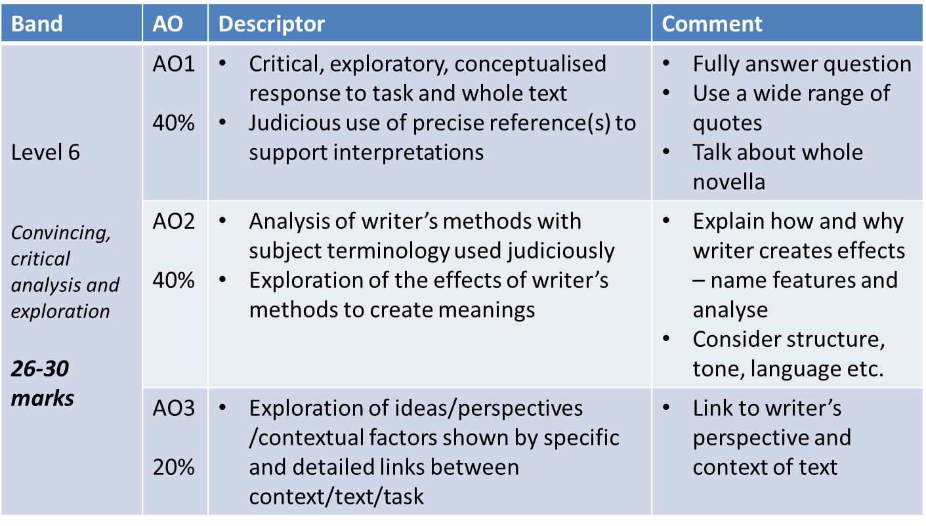
Assessment criteria

Slide 3
5 act structure
1 – setting, exposition and character
2 – romance
3 – violence and death
4 – fallout and ramifications
5 – tragedy and resolution

Slide 4
Prologue
Two households, both alike in dignity,
In fair Verona, where we lay our scene,
From ancient grudge break to new mutiny,
Where civil blood makes civil hands unclean.
From forth the fatal loins of these two foes
A pair of star-cross'd lovers take their life;
Whose misadventured piteous overthrows
Do with their death bury their parents' strife.
The fearful passage of their death-mark'd love,
And the continuance of their parents' rage,
Which, but their children's end, nought could remove,
Is now the two hours' traffic of our stage;
The which if you with patient ears attend,
What here shall miss, our toil shall strive to mend.

Slide 5
Key quote #1
“What, drawn and talk of peace?
I hate the word, as I hate hell
All Montagues and thee…”
Tybalt – act 1 scene 1

Slide 6
Key quote #2
“If ever you disturb our streets again,
Your lives shall pay the forfeit of the peace.”
Prince – act 1 scene 1

Slide 7
Key quote #3
“She will not stay the siege of loving terms…
Nor ope her lap to saint-seducing gold.”
Romeo – act 1 scene 1

Slide 8
Key quote #4
“But woo her gentle Paris, get her heart,
My will to her consent is but a part...”
Lord Capulet – act 1 scene 2

Slide 9
Key quote #5
“I would not for the wealth of all this town
Here in my house do him disparagement...
Am I the master here or you? go to!”
Lord capulet – act 1 scene 5

Slide 10
Key quote #6
“O she doth teach the torches to burn bright!
Did my heart love till now? forswear it, sight!
For I ne’er saw true beauty till this night. ”
Romeo – act 1 scene 5

Slide 11
Key quote #7
“If that thy bent of love be honourable
Thy purpose marriage... ”
Juliet – act 2 scene 2

Slide 12
Key quote #8
“For this alliance may so happy prove
To turn your households’ rancour to pure love.”
Friar lawrence – act 2 scene 3

Slide 13
Key quote(s) #8
“Romeo, the love I bear thee can afford
No better term than this: thou art a villain.”
Tybalt
“…Mercutio’s soul
Is but a little way above our heads
Staying for thine to keep him company.”
Romeo– act 3 scene 1

Slide 14
Key quote #9
“A plague on both your houses.”
mercutio– act 3 scene 1

Slide 15
Key quote #10
“…I will make a desperate tender
Of my child’s love: I think she will be ruled
In all respects by me…”
Lord Capulet– act 3 scene 4

Slide 16
Key quote #11
“Hang thee, young baggage, disobedient wretch!...
And you be mine, I’ll give you to my friend;
And you be not, hang, beg, starve, die in the streets…”
Lord Capulet– act 3 scene 5

Slide 17
Key quote(s) #12
“Hold, daughter, I do spy a kind of hope…”
Friar Lawrence– act 4 scene 1
“What if it be a poison which the Friar
Subtly hath ministered to have me dead…”
Friar Lawrence– act 4 scene 1

Slide 18
Key quote #13.1
“Death, that hath sucked the honey of thy breath,
Hath had no power yet upon thy beauty:
…beauty’s ensign yet
Is crimson in thy lips and cheeks…”
Romeo (is a moron)– act 5 scene 3

Slide 19
Key quote #13.1
“O here
Will I set up my everlasting rest,
And shake the yoke of inauspicious stars.”
Romeo - act 5 scene 3

Slide 20
Key quote #14
“Come, I’ll dispose of thee
Among a sisterhood of holy nuns…”
Friar Lawrence– act 5 scene 3

Slide 21
Key quote(S) #15
“Thy drugs are quick. Thus with a kiss I die.”
romeo
“Yea, noise? The I’ll be brief. O happy dagger,
This is thy sheath; there rust and let me die.”
Juliet– act 5 scene 3

Slide 22
Key quote #16
“See what a scourge is laid upon your hate,
That heaven finds means to kill your joys with love!”
prince– act 5 scene 3

