Slide 1
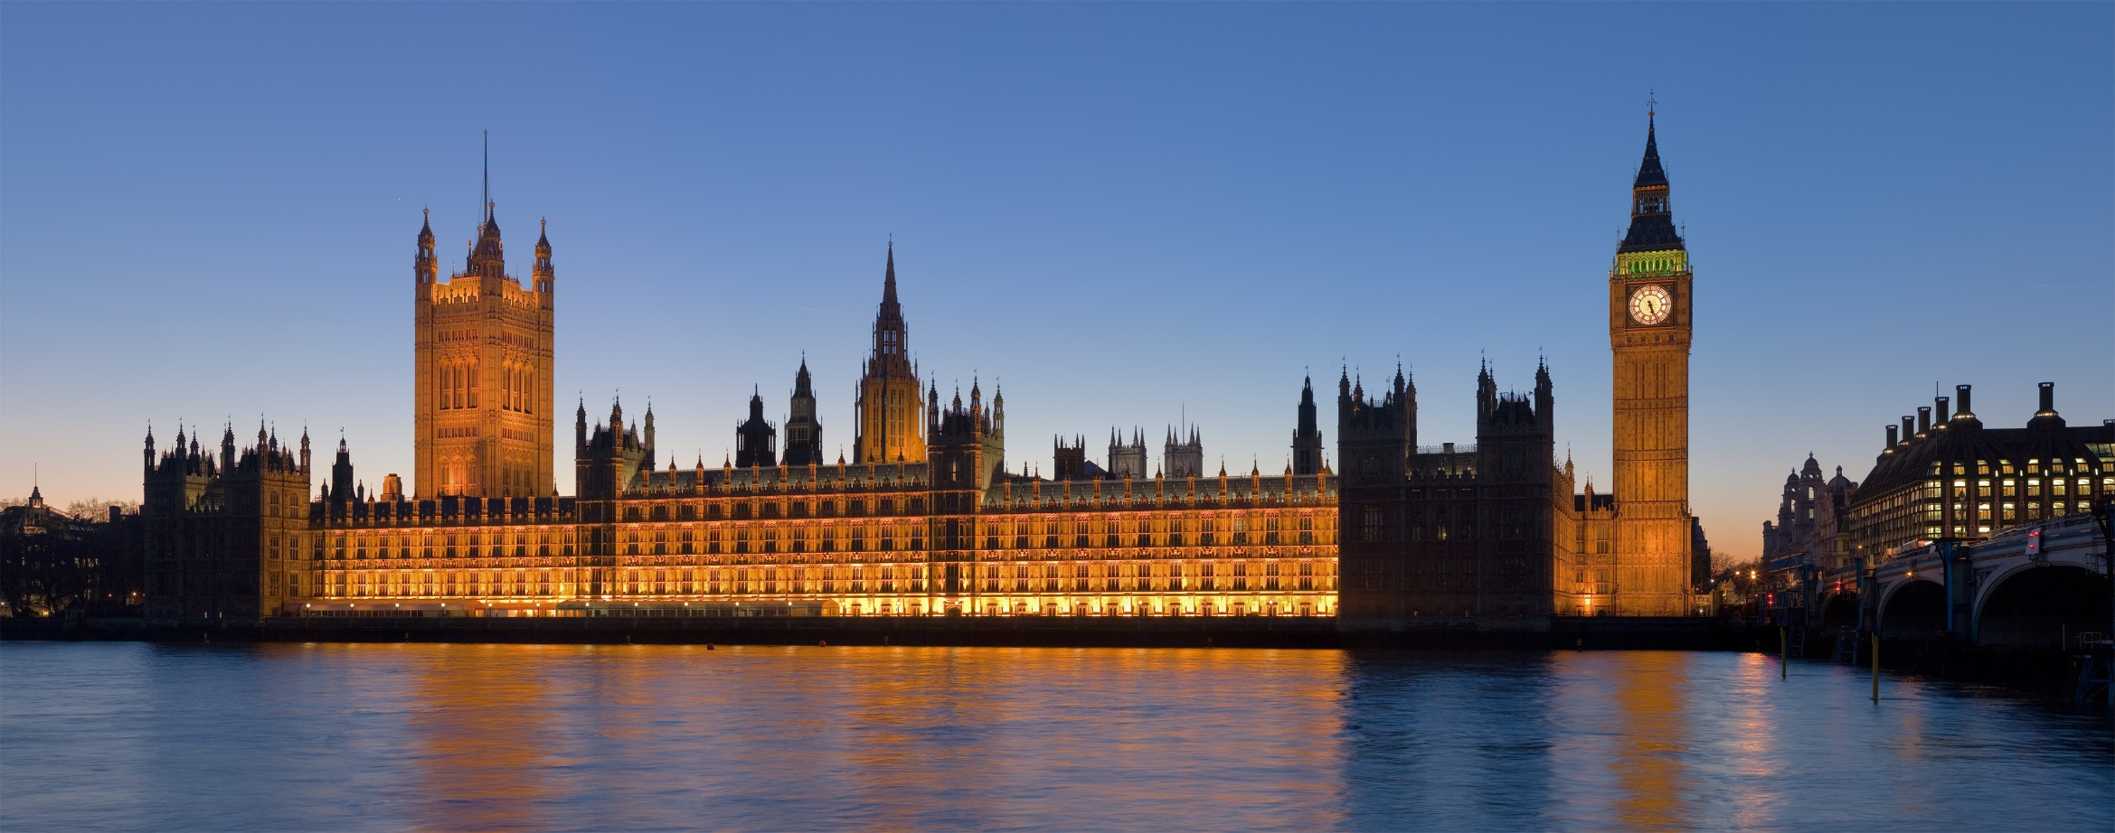
Houses of Parliament Trip

Slide 2
Why?
To reflect on democracy.
To learn about the history of parliament.
To understand how decisions are made that impact you.
To understand what makes Britain’s constitution (the way it organises itself) so unique.

Slide 3
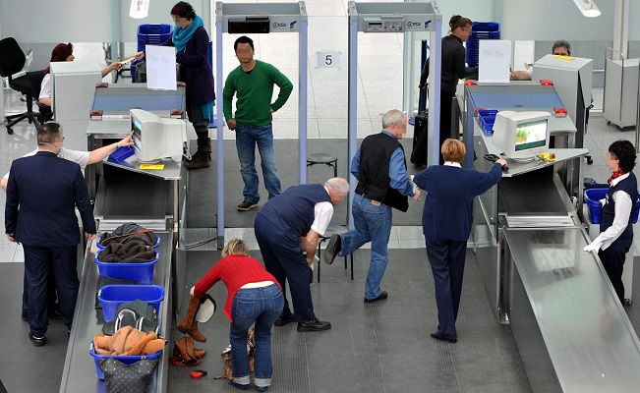
Plan for the day..(Wednesday 27th September)
8:45- Students gather in the main hall to register & and start getting on the coach
9:00- Coach leaves Mayfield.
11:30- Coach arrives at Houses of Parliament
12:00- Go through security for Parliament.
12:15- Tour starts
14:30- End of tour and start of 30 minutes allotted time in the education centre to eat lunch
15:00- Coach pick up.
17:00- Predicted arrival time at Mayfield.

Slide 4
Can I go on this trip?
Cost is £21.
Year 8 only
There are only 28 places.
First come, first served.
Behaviour will be taken into account. Should your behaviour not be very good you will not be allowed on this trip. We are very lucky to get this opportunity and Parliament is a very prestigious and important location. If you have a question about this then please speak to Miss Richards in Hut 62.

