Slide 1


Slide 2

Options
Year 9
13.3.25

Slide 3
Mayfield Curriculum Intent
We believe that our school motto, Believe. Achieve. Succeed, gives everyone within our school community a sense of direction, identity, and purpose. It helps us all:
To believe in ourselves, our own abilities, in other people and the world around us.
To achieve our full potential by successfully reaching our goals through effort, skill and confidence.
To succeed in becoming the person we want to be.

Slide 4
Mayfield Curriculum Intent
Our aim is to give Mayfield pupils the best possible opportunity
for a bright and prosperous future out in the wider world.
Our curriculum offer is ambitious and we want our pupils to aim high, therefore all pupils will study humanity with the majority of our pupils studying a language. This gives our pupils the best possible chances for a prosperous future.
To go along side this we want our pupils to foster a love of learning and have an opportunity to succeed in their passion, with a wide range of additional subjects on offer ensuring a broad and balanced approach.

Slide 5
Core Curriculum
All pupils will take the following;
English Language and Literature GCSEs
Mathematics GCSE
Double Science GCSEs
Physical Education (non-examined course)
Personal, Social Health Education PSHE (non-examined course)
AND 4 other subjects which depend on your option pathway.

Slide 6

Personal Development Curriculum
To go alongside our core curriculum we also provide opportunities for pupils to develop their character education through our personal development curriculum. This includes the tutor programme, extra –curricular, leadership opportunities and our personal development days.
Within our subject curriculum offer we endeavour to build in a range of visits and experiences to enhance and challenge pupils learning.

Slide 7
EBacc
The EBacc is a set of subjects at GCSE that keeps young people’s options open for further study and future careers. It consists of;
  English language and literature
  maths
  the sciences
  geography or history
  a language
A study by the UCL Institute of Education shows that studying subjects included in the EBacc provides students with greater opportunities in further education and increases the likelihood that a pupil will stay on in full-time education. Sutton Trust research reveals that studying the EBacc can help improve a young person’s performance in English and Maths.

Slide 8
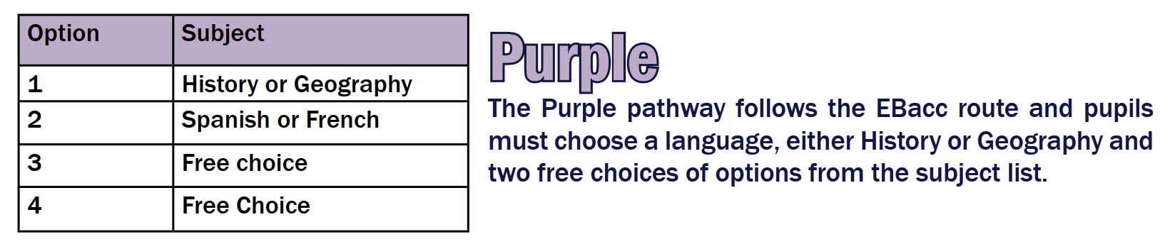
Option Pathways
There are three option pathways;

Slide 9
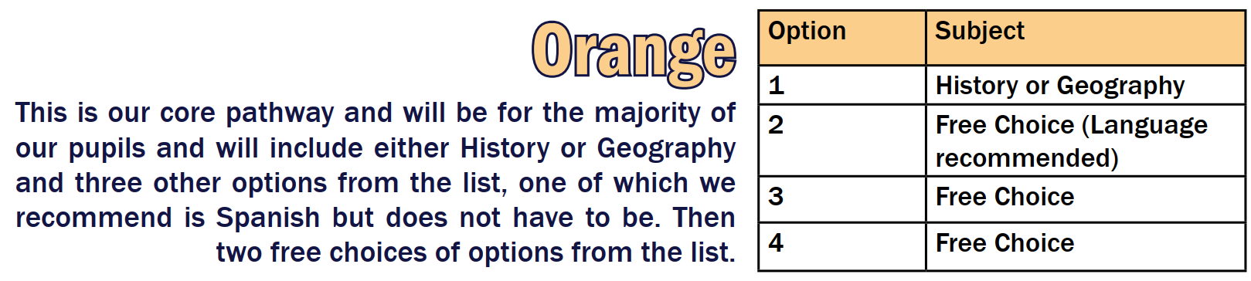
Option Pathways
There are three option pathways;

Slide 10
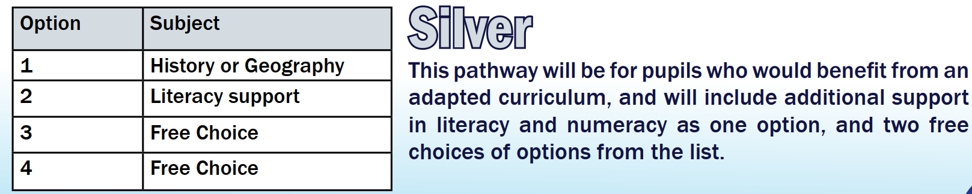
Option Pathways
There are three option pathways;

Slide 11
Option subjects available
Art *
Business Studies
Computer science
Child Development
Dance
Drama – BTEC
Drama – GCSE
Food Prep & Nutrition
French
Graphics
Geography
History
Music
PE- GCSE
Photography
Religious studies
Sociology
Spanish
Sports Studies
Travel and Tourism
Textiles*
4 new subject this year!
You have free choice of these options, and we will make every effort to ensure you are granted your first-choice options where possible. This is why it is important to put reserve choices.
You can not choose Art and Textiles as they are the same qualification just in different mediums.

Slide 12
What if I’m are not sure?
Ask your teachers, tutors, house team or any of the leadership team.
If you have any questions about careers please contact Mrs Munoz.
If you have any questions about options please contact Mrs Firth.

Slide 13
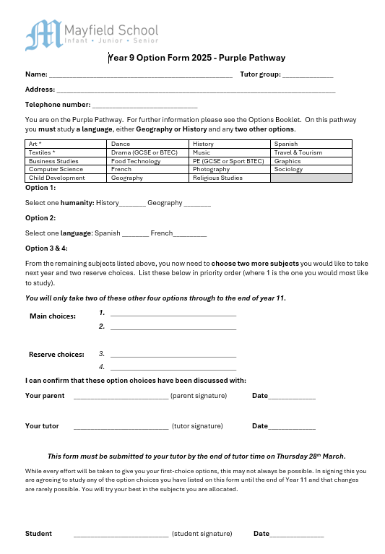
Options form
The form requires you to fill in some personal details, and then select your option choices depending on your pathway.
All pupils will choose between History and Geography.
Most pupils will choose a language.
All pupils will have free choice of two options.
Pupils are asked to give their two main choices and then two reserve choices.
While we always do our best to give pupils their top choices this isn’t always possible, in this case we will use their reserve choices.

Slide 14
Options process 2025
Careers Assemblies week commencing 3rd March
Option subject Assemblies week commencing 10th March
Options Evening Thursday 13th March- 6-7.00pm
Fortnight commencing 17th March – All pupils will have a 1:1 meeting with a member of their tutor team to discuss their option choices, to help guide and support them, ensuring they have made the right decisions for them.
Year 9 parents evening Thursday 27st March – 3.30-6.30pm- An opportunity to pre-book appointments to discuss your progress with all your teachers.
Friday 28th March- Options form deadline.

Slide 15
What next?
This evening – Collect your options pack and talk to the subject leaders and pupils representing the subjects you are interested in opting for.
Look up the college courses or apprenticeships you are interested in and check the course requirements.
Talk to your; parents and families, tutors and house teams to make sure you are making the right choices for you.
Complete your options form and get it signed by a parent, tutor and a member of your house team in your 1:1 meeting.
Hand your completed form to your tutor by the deadline of 28th March.

