Slide 1
Art, Photography, History, PE GCSE, Sports Studies

Slide 2
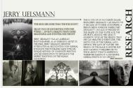
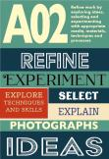
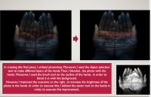
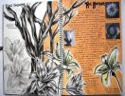
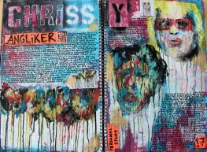
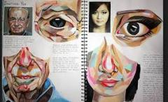
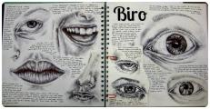
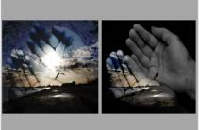
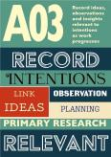
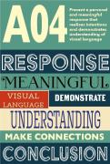
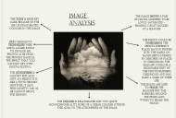
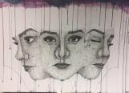
The Creative Arts and Technology department will be offering: Fine Art, Photography, Art Textiles, Graphics and Food Preparation and Nutrition
All of the Art options will provide you with a chance to explore and develop your creativity in a personal way! Each course is tailored towards delivering different techniques/skills to give you the opportunity that can lead you onto a path to a creative career that suits you!
All four Art based GCSE courses are made up of
Component 1- Personal portfolio (Coursework)- 60%- 1 main project and 1 side
Component 2- Externally set assignemt-40%
10 hour controlled assessment (project chosen by you)
Each course will require at least an hour a week of homework

Slide 3
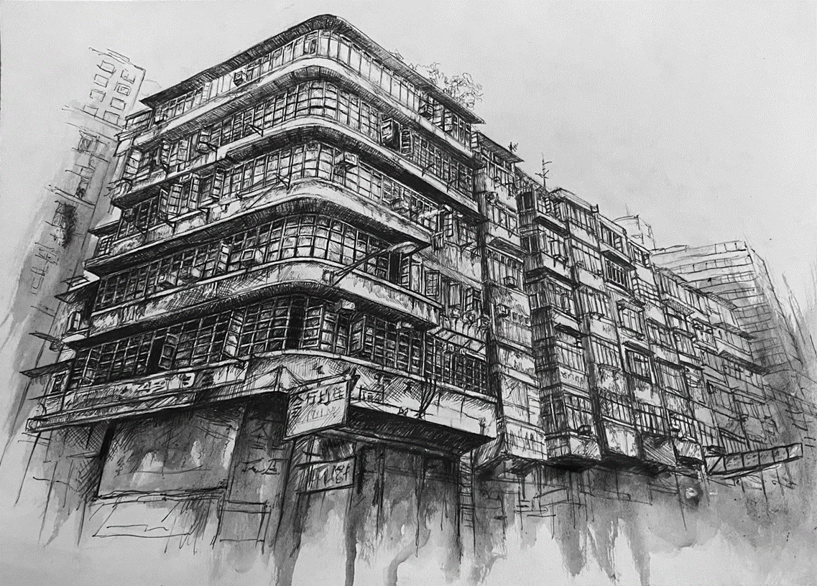
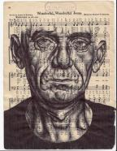
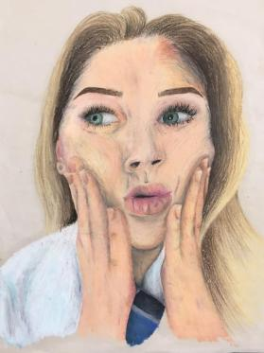
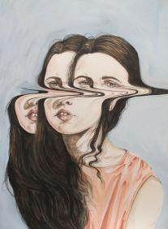
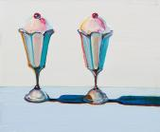
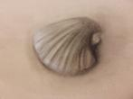
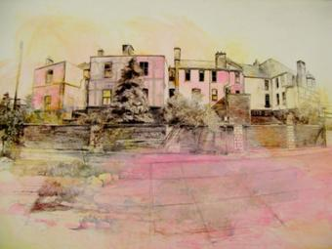
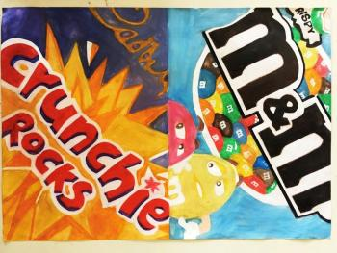
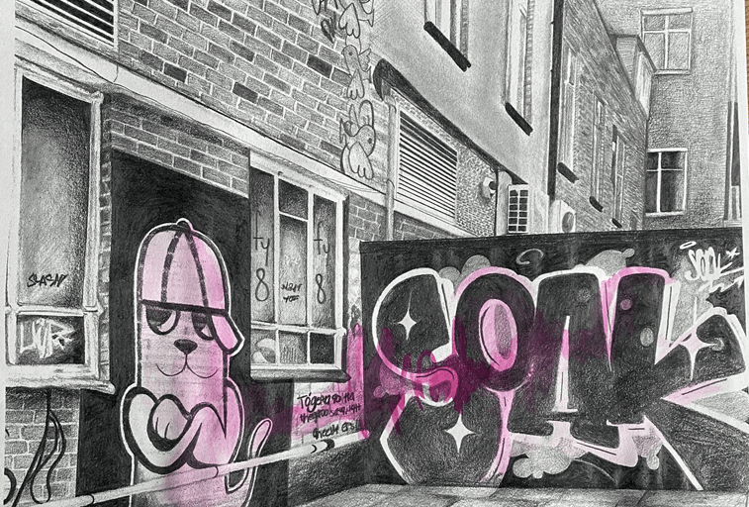
Fine Art
Skills- Observational drawing, drawing through different media, painting techniques, printmaking, multi-media work, sketchbook lay out
Careers
Exhibition designer, Visual Merchandiser, Illustrator, Print Maker,
Cartoonist, Artist, Graphic Designer,

Slide 4
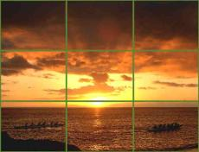
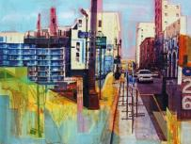
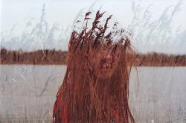
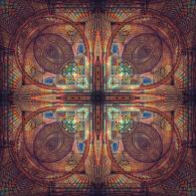
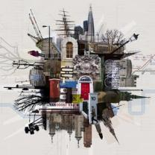
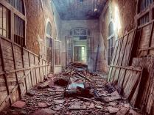
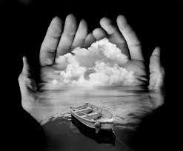
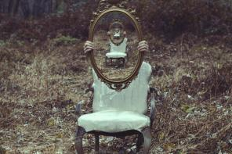
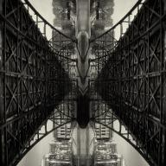
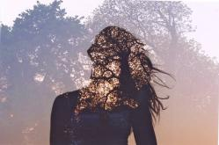
Photography
Skills- Camera skills-viewpoint/photoshoots, lighting, compositional techniques, digital manipulation of images through Photoshop
Careers- Working as a commercial photographer, working in local and national media, digital marketing, graphic design, magazine features editor, television camera operator, web designer, media planner

Slide 5
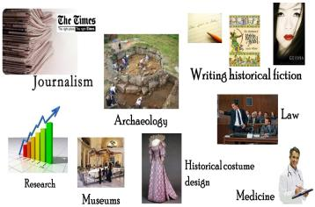
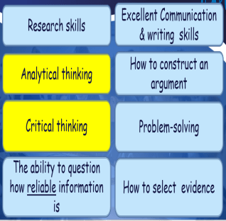
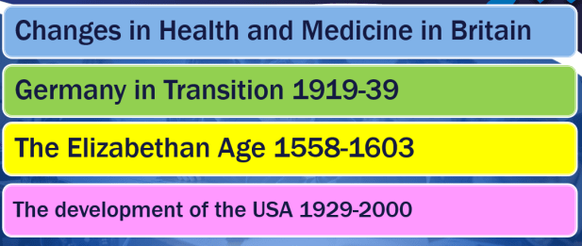
Questions to consider
Will it help me in my career?
What skills will I develop?
Will I enjoy the content?
Topics

Slide 6
PE GCSE, Sports Studies
If you love playing sports, staying active, or learning how to improve your performance, PE lets you explore that in more depth. You get to study things like training methods, sports psychology, and how the body works during exercise.

