Slide 1
Thursday – Textiles, Drama, Drama Btec, Dance & Music

Slide 2
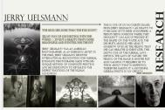
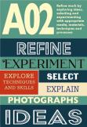
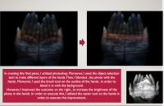
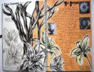
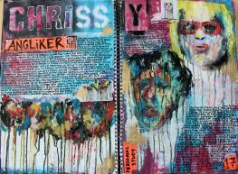
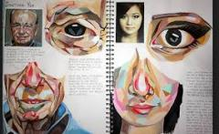
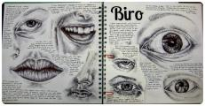
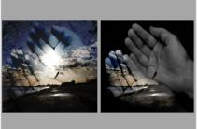
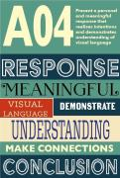
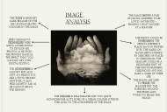
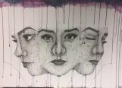
The Creative Arts and Technology department will be offering: Fine Art, Photography, Art Textiles, Graphics and Food Preparation and Nutrition
All of the Art options will provide you with a chance to explore and develop your creativity in a personal way! Each course is tailored towards delivering different techniques/skills to give you the opportunity that can lead you onto a path to a creative career that suits you!
All four Art based GCSE courses are made up of
Component 1- Personal portfolio (Coursework)- 60%- 1 main project and 1 side
Component 2- Externally set assignemt-40%
10 hour controlled assessment (project chosen by you)
Each course will require at least an hour a week of homework

Slide 3
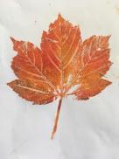
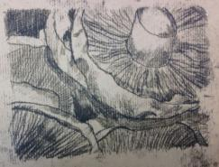
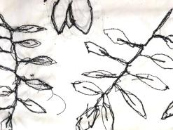
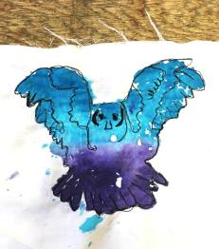
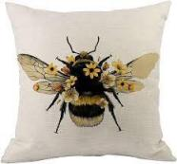
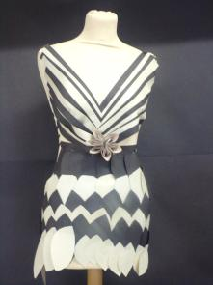
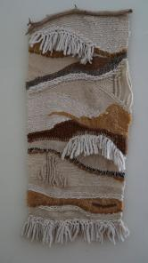
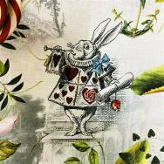
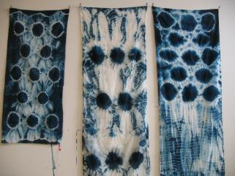
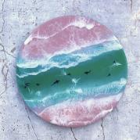
Art Textiles- Skills- Fabric manipulation, free machine embroidery, embroidery, applique, reverse applique, marbling, felting, tie dye, batik waxing
Careers-fashion design, fashion retail, fabric/textiles designer, pattern making, operating textiles machines in business, interior design, fashion journalism, fashion illustrator or a career in fashion, visual merchandiser, textiles designer

Slide 4
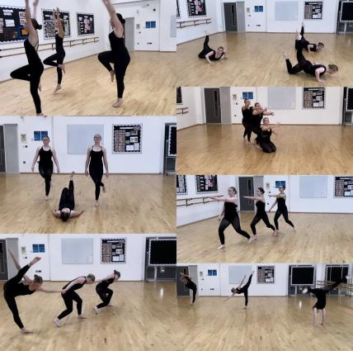
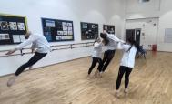
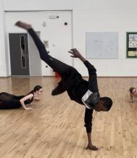
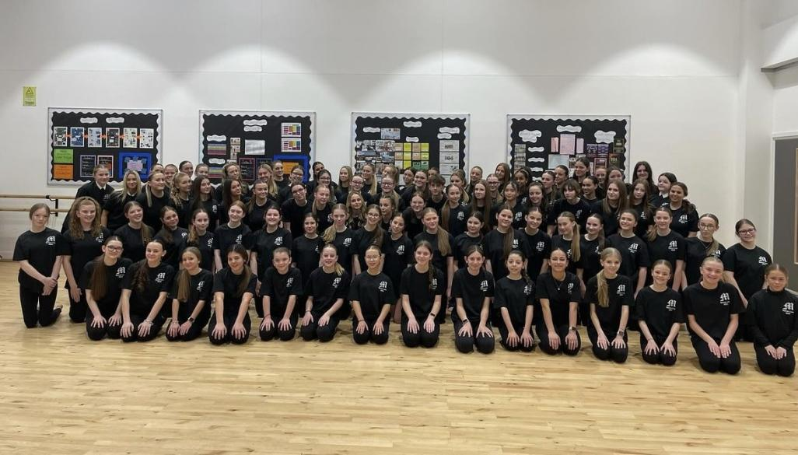
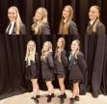
GCSE DANCE 2025-27

Slide 5
ALL ABILITIES WELCOME
Dance is a powerful and expressive subject which encourages students to develop their creative, physical, emotional and intellectual capacity, whatever their previous experience in the subject.

Slide 6
The question you need to ask yourself is do you enjoy the subject? We would like students who are dedicated, can push themselves physically and to be able to think creatively.

Slide 7
DANCE EXAM
2 X 30 SECOND SOLO'S
DUET/TRIO - DURATION OVER 3 MINUTES
CHOREOGRAPHY – DURATION OVER 3 MINUTES
Written Exam – 1 hour and 30 Minutes

Slide 8
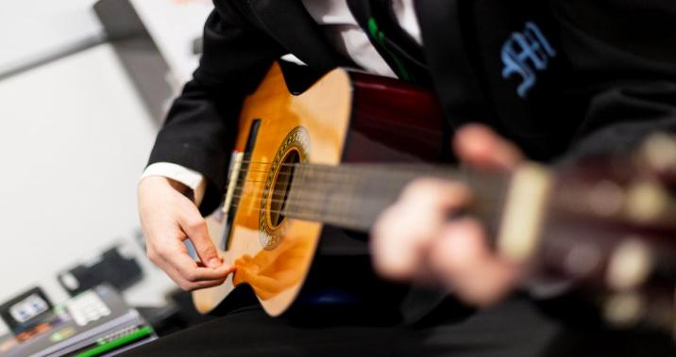
BTEC MUSIC
3 COMPONENTS
2 YEARS
YOUR CHOICE

Slide 9
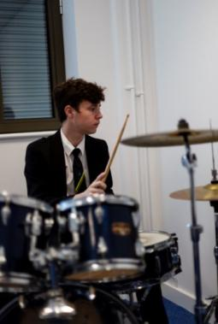
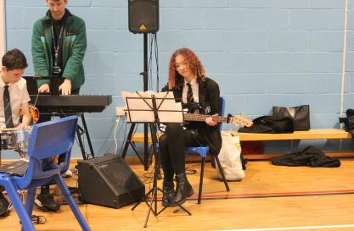
REQUIREMENTS
BTEC MUSIC REQUIRES YOU TO BE ​
CREATIVE, RESILIENT AND AMBITIOUS
YOUR MUSICAL ABILITIES WILL BE CHALLENGED IN A FUN AND CREATIVE WAY
​
​
YOU MUST LOVE MUSIC!​

Slide 10
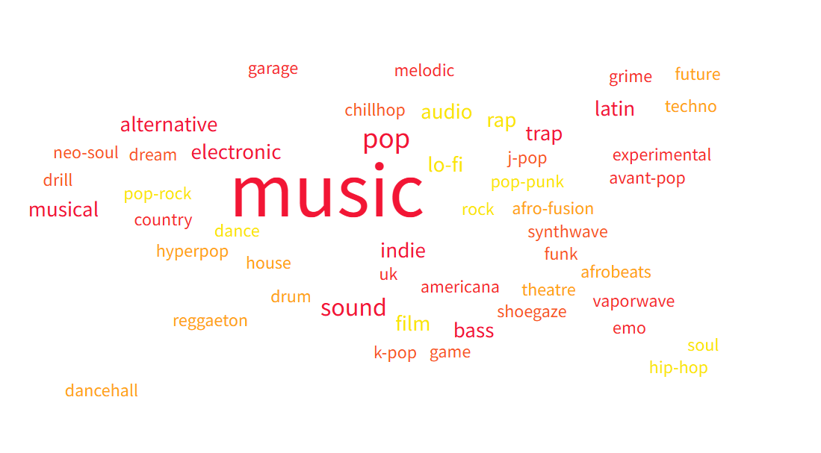
What types of music can you study?

Slide 11
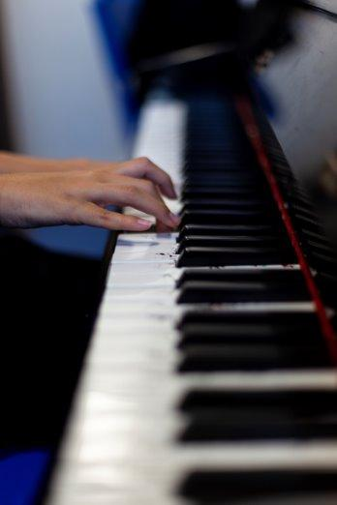
How is the 2 year BTech course made up?
Component 1 – Exploring Music Products and Styles (30%)
Learn 5 genres, then create a portfolio (40%)
Create 3 songs solo or in a group (60%)
Component 2 – Music Skills Development (30%)
Choose your own personal music goals and smash them!
Develop 2 skills over 15 hours (written & practical)
Component 3 – Responding to a Music Brief (40%)
Remix an existing song into a new style

Slide 12
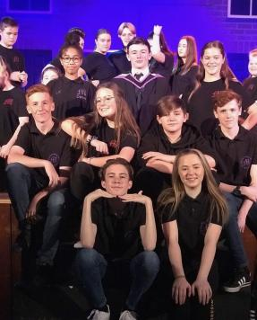
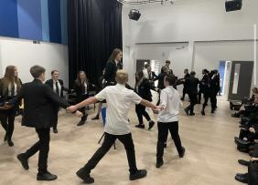
GCSE DRAMA BTEC DRAMA 2025-27

Slide 13
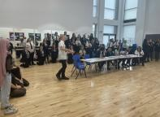
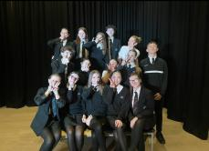
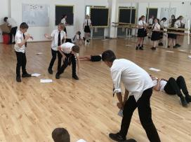
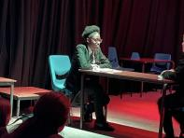
The main requirement for this GCSE is that you love drama, are hard working and prepared to work with anyone in the class. It is definitely not an easy option but it is a lot of fun.

Slide 14
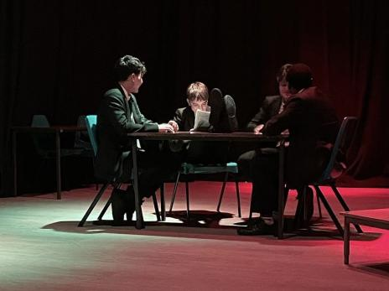
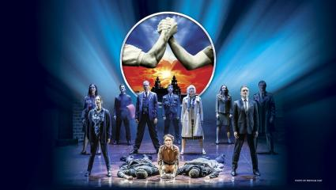
GCSE - DRAMA
60% Practical
30% Devising performance and portfolio.
30% Performance exam - Script
40% written Exam
Section A- Based on a set text Blood Brothers
Section B – based on a performance you will see at the theatre.

Slide 15
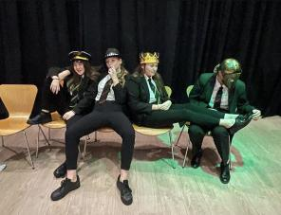
BTEC - DRAMA
Component 1: Exploring the Performing Arts 30%
You’ll learn about different styles of performance and how professionals work in the industry.
You’ll be assessed through coursework (written and practical work).
Component 2: Developing Skills and Techniques in the Performing Arts 30%
You’ll take part in workshops and performances to improve your acting and movement skills.
You’ll be assessed on your practical performance and written reflections.
Component 3: Responding to a Brief 40%
You’ll be given a scenario and will have to create a performance in response.
You get 12 weeks to prepare, then a final 3-hour assessment to perform and reflect on your work.

