Slide 1
Friday – Geography, Sociology, Child Development

Slide 2
Paper 1:
Living with the Physical Environment.
1 hour 30 minutes exam.
88 marks.
35% of your grade.
Section A:
The Challenge of Natural Hazards.
Section B:
The Living World.
Section C:
Physical Landscapes in the UK. Coasts and rivers.
Paper 2:
Challenges in the Human Environment.
1 hour 30 minutes exam.
88 marks.
35% of your grade.
Section A:
Urban Issues and Challenges.
Section B:
The Changing Economic World.
Section C:
The Challenge of Resource Management.
Focus on water resources.
Paper 3:​​
Geographical Applications.​​
1 hour 30 minutes exam.​​
76 marks.​​
30% of your grade.​​
​​
Section A:​​
Issue Evaluation.​​
Make a decision on a geographical issue outlined in a booklet published before the exam.​​
​​
Section B:​​
Fieldwork.​​
Enquiry 1: To what extent are the coastal defences in Portsmouth effective​​
​​
Enquiry 2: To what extent is the Gunwharf redevelopment effective.​​

Slide 3
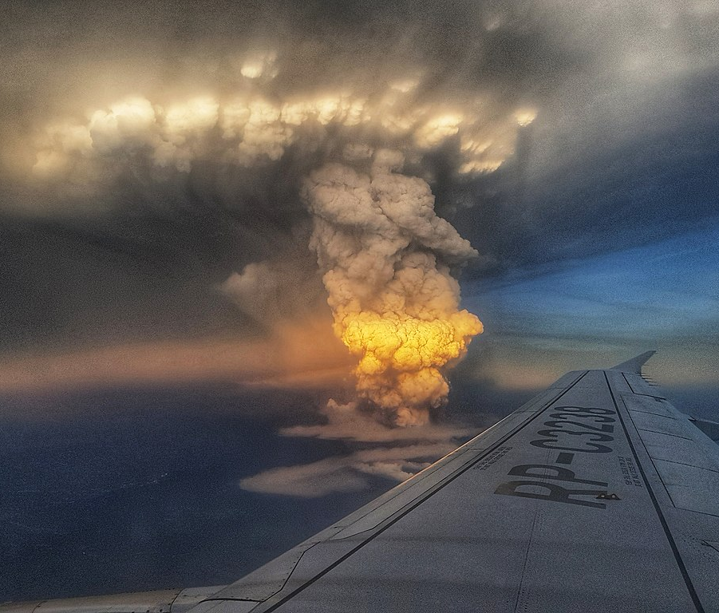
Travel and Tourism
2x pieces of coursework and 1 exam
Component 1 – Explore the sector
Travel and Tourism Organisations and Destinations
Internal Assessment (controlled assessment) Pass, Merit, Distinction
30%
Component 2 – Develop Skills
Customer Needs in Travel and Tourism
Internal Assessment (applying skills)Pass, Merit, Distinction
30%
Component 3 – Apply knowledge
Factors affecting global travel and tourism
External Written Assessment (exam)
Pass, Merit, Distinction
40%

Slide 4
Child Development - OCR Cambridge National
Unit R057: Health and well-being for child development (Exam)
o Pre-conception health and reproduction o Antenatal care and preparation for birth
o Postnatal checks, postnatal care and the conditions for development
o Childhood illnesses and a child safe environment.
Unit R058: Create a safe environment and understand the nutritional needs of children from birth to five years (Set assignment)
o Creating a safe environment in a childcare setting
o Choosing suitable equipment for a childcare setting
o Nutritional needs of children from birth to five years.
Unit R059: Understand the development of a child from one to five years (Set assignment)
o Physical, intellectual and social developmental norms from one to five years
o Stages and types of play and how play benefits development
o Observe the development of a child aged one to five years
o Plan and evaluate play activities for a child aged one to five years for a chosen area of development

Slide 5
As part of the Cambridge National, you’ll cover:
• health and wellbeing for child development, creating conditions in which children can thrive
• creating safe environments for children
• the nutritional needs of children from birth to five years, plus investigating and choosing equipment
• the development of a child from one to five years, using observation and research techniques

Slide 6
Why choose Child development
By developing applied knowledge and practical skills, this course will help give you the opportunity to progress on to A Levels, a Cambridge Technical in Health and Social Care, an apprenticeship or university.
Child Development could be the first step of a career as a Nursery Nurse, an Early Years Teacher, Family Support Worker, Nursery Manager, Children’s Nurse, Social Worker and more.

