Slide 2
Options 2025
Year 9

Slide 3
Core Curriculum
All pupils will take the following;
English Language and Literature GCSEs
Mathematics GCSE
Double Science GCSEs
Physical Education (non-examined course)
Personal, Social Health Education PSHE (non-examined course)
AND 4 other subjects which depend on your option pathway.

Slide 4
EBacc
The EBacc is a set of subjects at GCSE that keeps young people’s options open for further study and future careers. It consists of;
English language and literature
maths
the sciences
geography or history
a language

Slide 5
Option Pathways
There are three option pathways;
Or French

Slide 6
Option Pathways
There are three option pathways;

Slide 7
Option Pathways
There are three option pathways;
Study

Slide 8
Option subjects available
Geography
History
Music
PE- GCSE
Photography
Religious studies
Sociology
Spanish
Sports Studies
Travel and Tourism
Textiles*
Art *
Business Studies
Computer science
Child Development
Dance
Drama – BTEC
Drama – GCSE
Food Prep & Nutrition
French
Graphics
4 new subject this year!
You have free choice of these options, and we will make every effort to ensure you are granted your first-choice options where possible. This is why it is important to put reserve choices.
You can not choose Art and Textiles as they are the same qualification just in different mediums.

Slide 9
What if I’m not sure?
Ask Questions!
Ask your teachers, tutors, house team or any of the leadership team.
If you have any questions about careers please contact Mrs Munoz.
If you have any questions about options please contact Mrs Firth.

Slide 10
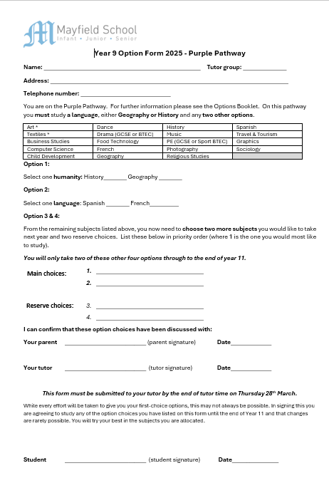
Options form
The form requires you to fill in some personal details, and then select your option choices depending on your pathway.
All pupils will choose between History and Geography.
Most pupils will choose a language.
All pupils will have free choice of two options.
Pupils are asked to give their two main choices and then two reserve choices.
While we always do our best to give pupils their top choices this isn’t always possible, in this case we will use their reserve choices.

Slide 11
Options process 2024
Careers Assemblies week commencing 3rd March
Option subject Assemblies week commencing 10th March
Options Evening Thursday 13th March- 6-7.00pm – All parents and pupils encouraged to attend, you will be given your options form and booklet on this evening.
Fortnight commencing 19th March – All pupils will have a 1:1 meeting with their tutor to discuss their option choices, to help guide and support them, ensuring they have made the right decisions for them.
Year 9 parents evening Thursday 27th March – 3.30-6.30pm- An opportunity to pre-book appointments to discuss your progress with all your teachers.
Thursday 28th March- Options form deadline.

